Slide 1

The Outbreak of Covid-19
to Anti-Asian Crime Rate
Chuqiao Sun, Ping-Hsuan Lin
Wan Ting Hsu, Zikang Chen

Slide 2
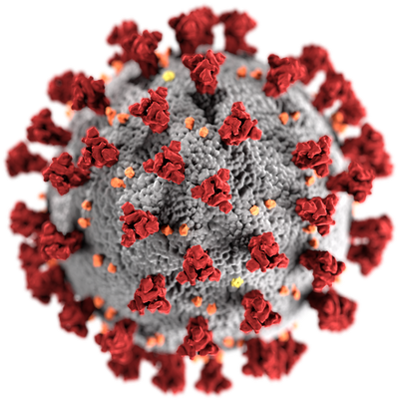

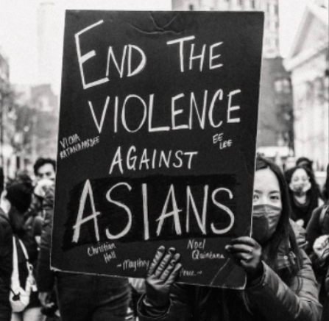
Background
Asian Americans are blamed for spread of Covid-19, leading to the surge of anti-Asian crimes. But bias motivation from race/ ethnicity/ ancestry has been happening throughout the history.
Our goal is to clarify if the Covid-19 causes the change in the anti-Asian crime rate in New York City.
A crime record dataset from NYC Open Data from March 2010 to the end of the 2021 is used for the research.

Slide 3

Data description and pre-statistic test
Data description
Two sample T-test
1
Source
2
Simple Linear Regression Model + Correlation
Time span
March 2010 - December 2021
NYC Open Data
449,506 obs
36 variables
All kinds of crimes
Anti-Asian crimes
3
Variables
4
Two time periods
Results of the Test
Before-Covid-19
After-Covid-19
Time
Crime Type
Victim Race
P-value: 0.00237
Coefficient: 3.6450
Significant positive correlation

Slide 4
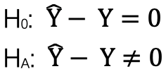


Research question and Hypothesis
Research question
Does Covid-19 change the anti-Asian crime rate?
Note: anti-Asian crime rate is the cases count anti-Asian crimes divided by the total number of crimes.
hypothesis
: The predicted rate during the Covid-19 period
: The actual rate during the Covid-19 period

Slide 5
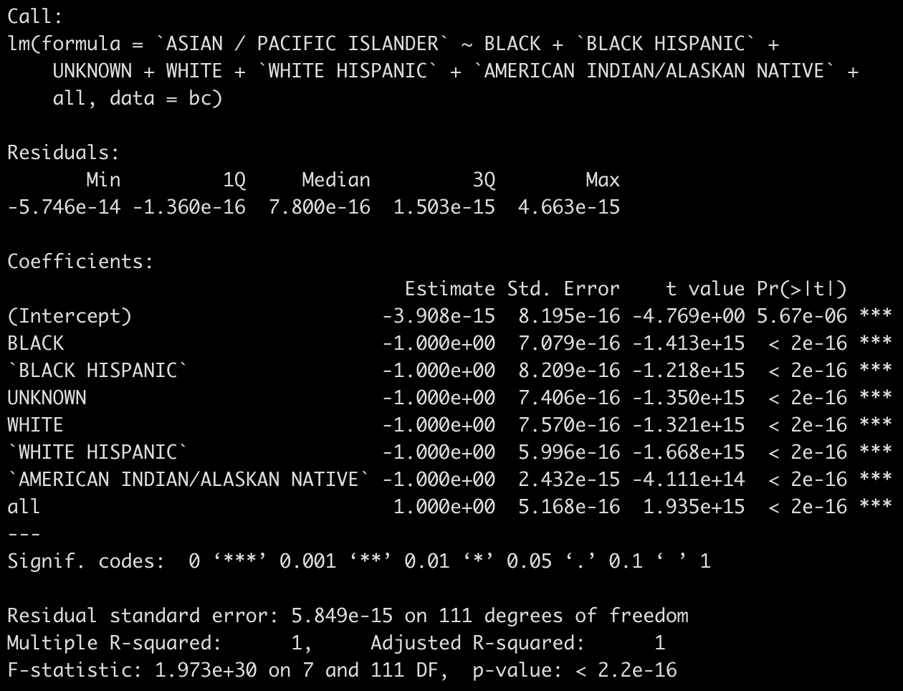
Analytical Techniques
Data Cleaning & Manipulation
Correlation Analysis
Time Series Forecasting
difference in mean
Create 2 datasets:
Before covid (bc) - 2010/03 - 2020/02/29
After covid (ac) - 2020/03-2021/12/31
Both datasets include :
date, asian crime count, other races’ crime counts, total crime count
Linear regression - anti Asian crime highly correlated with all of them
Asian Crime Ratio - Aisan crime/total crime
Bayesian Structural Time Series (BSTS)
ss<-AddLocalLinearTrend(list(), bc$ratio)
ss <- AddSeasonal(ss, bc$ratio, nseasons = 12)
model1 <- bsts(bc$ratio, state.specification = ss, niter = 1000, seed = 5205)
Forecast after covid asian crime rate using bc data
Pred <- predict(model1, horizon = 22, seed = 5205)
Visualization
Plot prediction and actual ac data for visualization
Quantify the result
Two sample t-test to find out the difference in mean between after covid asian crime prediction and actual asian crime
t.test(pred_df$ratio,ac$ratio)

Slide 6
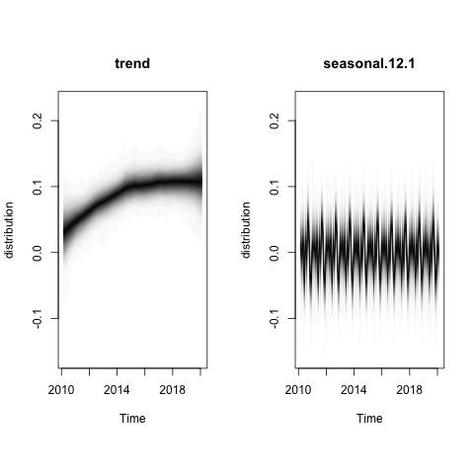
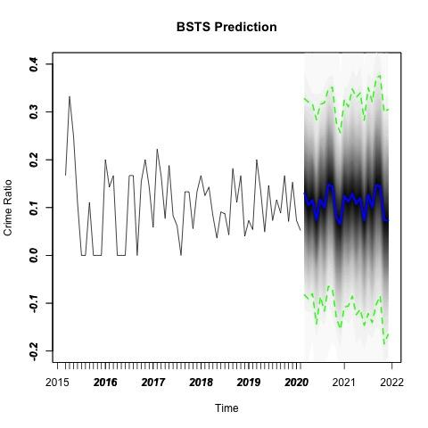
Graph 1: Estimated trend component and seasonal component of before covid asian crime.
Graph 2: Prediction of after covid Asian Crime using before covid BSTS model with 95% prediction credible interval.
Graph 1
Graph 2

Slide 7
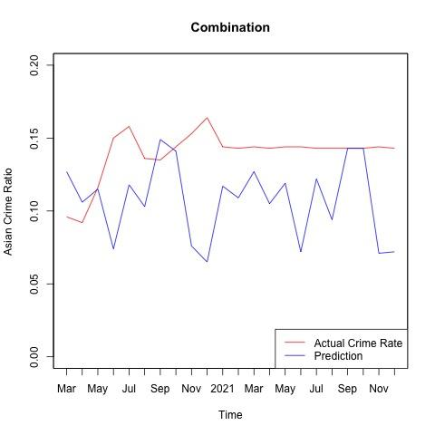
Combining prediction and actual crimE rate
Hypotheses:
H0: E(Y1) - E(Y1^) = 0
HA: E(Y1) - E(Y1^) ≠ 0
E(Y1): After covid Asian crime ratio
E(Y1^): Pre covid prediction for after covid Asian crime ratio
Welch Two Sample t-test
t = -4.712, df = 35.988, p-value = 3.612e-05
95 percent confidence interval:
-0.04531817 -0.01804547
sample estimates:
mean of x mean of y
0.1076364 0.1393182
p-value < 0.05, Reject H0

Slide 8
Conclusion & Recommendations
P-value is less than the significance level (95%). Therefore, the Covid-19 pandemic has a statistically significant effect on anti-Asian crime rate in NYC.
Limitations: The amount of information (time period) given for predictive crime may be limited or irrelevant to prediction. Eg. Omitted variables like Trump’s appearance bringing the burst of nationalism and xenophobia.
Recommendations: Restorative justice programs and social services to mend individual, and community harms, and to provide professional support, compensation and mental health service
Interesting Findings: Crime ratio ↑ Asian, Hispanic, American-indian / ↓Black, white

Slide 9


